Slide 1

Gender Classification Project
This presentation explores a gender classification project using machine learning and deep learning models. It covers the project from data preprocessing through model evaluation and comparison, providing insights into model performance and future directions.

Slide 2

Gender Classification: Overview
Gender classification is the process of identifying an individual's gender based on various factors. This task has numerous applications, ranging from targeted marketing to personalized healthcare experiences.
Predictive models use algorithms trained on datasets containing information about individuals' genders and associated features. These models learn the relationship between features and gender, enabling them to predict gender based on new data.

Slide 3
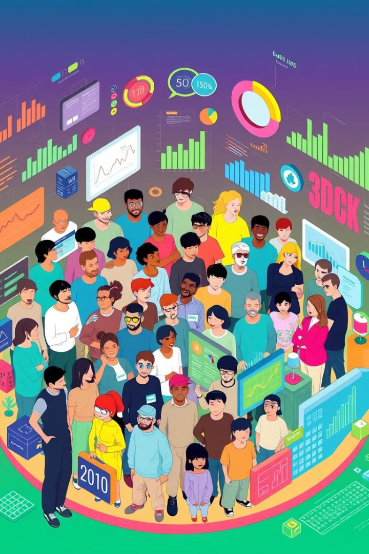
Data Collection
The dataset used for gender classification was sourced from Kaggle. It contains information about individuals, including their gender, age, height, weight, and other relevant features.
This dataset provides valuable insights into the relationships between these features and an individual's gender. It serves as the foundation for building and evaluating predictive models.
This is the link to the dataset.

Slide 4

Data Preprocessing and Cleaning
1
Data Loading
2
Data Cleaning
We began by loading the dataset into our environment, preprocessing the data to handle any missing values and preparing it for model training.
We removed any incomplete or corrupted data points and addressed potential biases by carefully evaluating the data's representativeness.
3
Data Augmentation
4
Data Standardization
We enhanced the dataset by generating synthetic samples through techniques such as oversampling minority classes, creating variations in the data, and introducing slight modifications to increase the diversity and robustness of the model's training set.
We standardized the dataset by scaling features to a common range, ensuring that each feature contributes equally to the model's performance and improving overall training efficiency.

Slide 5
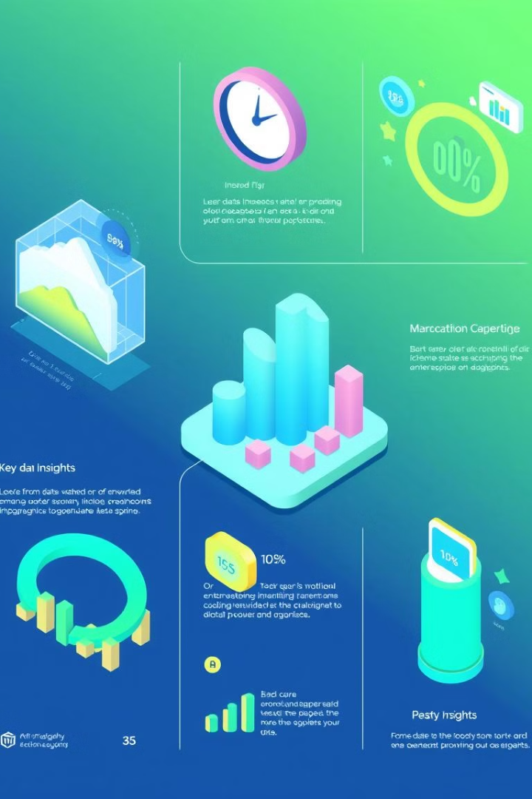
Exploratory Data Analysis
Visualizations
Insights
Data Balance
We created histograms, box plots, and scatter plots to explore the distribution of features and identify potential relationships within the data.
Through EDA, we identified key characteristics that contributed to gender classification, guiding feature selection and model training.
We analyzed the dataset for any class imbalances, ensuring the model wouldn't favor one gender over another during training.

Slide 6

Feature Engineering and Selection
Feature
Description
Facial Features
Eye shape, nose length, brow shape, mouth width
Hair Style
Hair length, color, texture, presence of accessories
Clothing Style
Garment type, color, patterns, accessories
Body Shape
Height, weight, posture, body proportions

Slide 7





Machine Learning Model Implementation
Logistic Regression
Support Vector Machines
Random Forest
Decision Tree
A simple yet effective model that uses a linear decision boundary to classify gender based on extracted features.
An ensemble learning method that combines multiple decision trees to make more accurate predictions, improving robustness and accuracy.
A tree-based model that makes decisions by splitting data into branches based on feature values, leading to straightforward and interpretable predictions.
A powerful model capable of finding the optimal hyperplane to separate data points based on different gender classes.

Slide 8
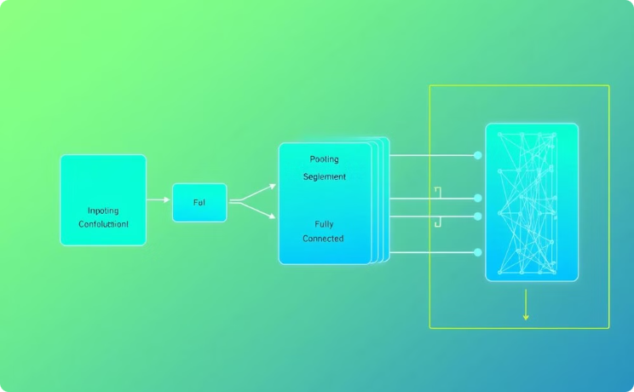
Deep Learning Model Implementation
Artificial Neural Networks(ANN)
ANNs are computational models inspired by the human brain, consisting of layers of interconnected neurons. For gender classification, an ANN processes input features, through multiple hidden layers, where each neuron applies a weighted sum followed by an activation function. The network learns to capture patterns and relationships within the data through back propagation, adjusting the weights to minimize prediction errors. Over time, the ANN becomes capable of distinguishing gender by recognizing subtle patterns in the input data, such as facial features or textures, enabling it to classify new images with improved accuracy.

Slide 9

Evaluation Metrics and Model Performance
Metric
Description
Accuracy
Overall percentage of correct predictions.
Precision
Fraction of correctly predicted positive cases among all predicted positives.
Recall
Fraction of correctly predicted positive cases among all actual positives.
F1 Score
Harmonic mean of precision and recall, balancing both metrics.
Confusion Matrix
A table showing the actual vs. predicted classifications, detailing true positives, false positives, true negatives, and false negatives.

Slide 10
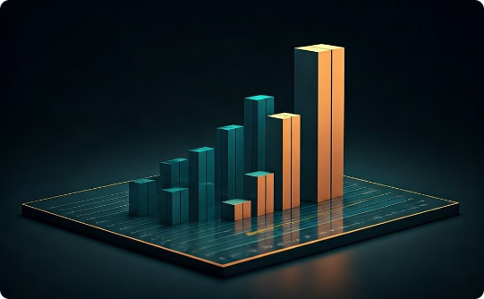
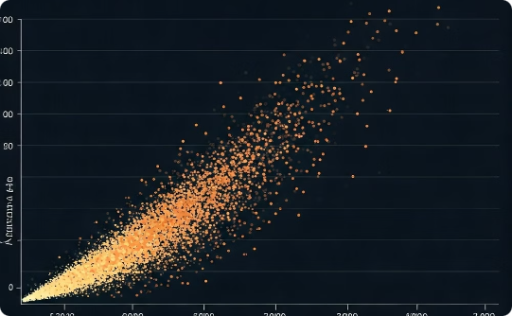
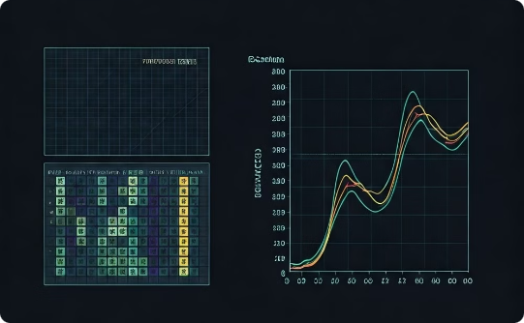
Comparison of Model Performances
Best Performing Model
Performance Analysis
Visualization
The Machine learning model based on Random Forest consistently outperformed other models, achieving higher accuracy and robustness.
We compared the performance of different models using metrics like accuracy, precision, recall, and F1-score, highlighting the model's strengths and weaknesses.
We visualized the model performances using confusion matrices, accuracy providing a clear visual representation of the model's strengths and limitations.

Slide 11
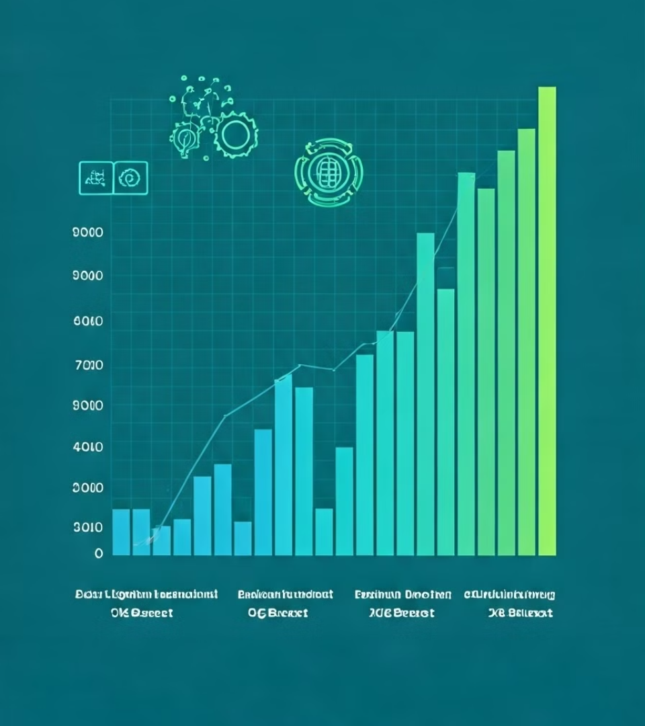
Interpretation of Results
1
Logistic Regression
Train Accuracy: 97.1%
Test Accuracy: 96.4%
2
Support Vector Classifier
Train Accuracy: 97.77%
Test Accuracy: 96.50%
3
Decision Tree
Train Accuracy: 98.42%
Test Accuracy: 96.30%
4
Random Forest
Train Accuracy: 98.82%
Test Accuracy: 96.90%
5
ANN
Train Accuracy: 97.54%
Test Accuracy: 96.80%

Slide 12

Conclusion and Future Directions
We successfully developed a gender classification system using machine learning and deep learning models, achieving high accuracy and performance. We plan to explore advanced techniques, including transfer learning and adversarial learning, to further enhance model performance and address potential biases. Furthermore, we aim to investigate the impact of data augmentation and feature engineering on model performance, potentially leading to even more robust and accurate predictions. This research opens doors for future applications in various fields, including healthcare, education, and social science, with the potential to contribute to a more inclusive and equitable society.

